Slide 1
Natural Language Processing

Slide 2
Agenda
What is NLP?
Applications of NLP
NLP Libraries
Text Pre Processing Techniques
NLTK, Spacy, Text Blob, Stanford NLP
String Similarity
Projects

Slide 3
Project details
Spam classifier
Assignment – fake news detection

Slide 4
What is Natural Language?

Slide 5
Any language in which humans are making a conversation that language is the Natural language

Slide 6
What is NLP ?
Natural language processing (NLP) is a field of artificial intelligence in which computers analyze, understand, and derive meaning information from human language in a smart and useful way

Slide 7
By utilizing NLP, developers can organize and structure knowledge to perform tasks such as automatic summarization, translation, named entity recognition, relationship extraction, sentiment analysis, speech recognition, and topic segmentation.

Slide 8
Application of NLP

Slide 9
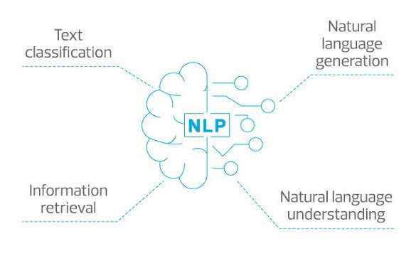

Slide 10
Optimize customer service
- providing answers faster (through the web, chatbots, or voice applications like smart speaker apps)
- NLP allows companies to spend less on human service agents, office spaces, phones, and other costs.

Slide 11
Learn from customer data
NLP lets companies glean more insights from customer data regardless of its source, size, or format.

Slide 12
Augment text-intensive tasks
Automating task using NLP-based applications.
- This has already been successfully applied to spam detection
- categorizing heaps of resumes via automation.

Slide 13
Search beyond keywords
Applying NLP to search produces results based on an understanding of the meaning of the query instead of just by matching the keywords.

Slide 14
NLP Libraries
NLTK ( Natural Language Tool-Kit)
Text Blob
Spacy
Stanford NLP

Slide 15
Text Analytics/ Text Mining

Slide 16
It is process of deriving the meaningfull information from the natural languages text

Slide 17
Text Analytics is Nothing but the preprocessing that is required before giving the data to the model

Slide 18
In Machine learning we have data preprocessing
In NLP we called it as text analytics

Slide 19
Tokenization
There are two parts
1. Sentence tokenization
2. word tokenization

Slide 20
But why we need Tokenization?

Slide 21
Because NLP algorithm works on the weights of the word

Slide 22
But How this weigths are calculated?

Slide 23
This a based on how many times the word is occuring in a sentence ( count of word in sentence or document
Methods to do so – TF-IDF , Bag of words

Slide 24
Example in user comments
- if the count of the words like happy , satisfied and good occured for more number of times then that means that its a positive sentence
-if the count of the words like sad , not-satisfied and bad occured for more number of times then that means that its a negative sentence

Slide 25
Lets see tokenization with the help of coding

Slide 26
POS(Parts of speech) tagging

Slide 27
Once we have tokenized our word then the next step is to identify that which part of speech that sentence belongs to

Slide 28
Lets see the code

Slide 29
Chunking

Slide 30
After using parts of speech, Chunking can be used to make data more structured by giving a specific set of rules

Slide 31
Lets see the how to do chunking with the help of code

Slide 32
Stopwords

Slide 33
Stop words are such words which are very common in occurrence such as ‘a’,’an’,’the’, ‘at’ etc
We ignore such words during the preprocessing part since they do not give any important information and would just take additional space

Slide 34
We can make our custom list of stop words as well if we want
Different libraries have different stop words list. Let’s see the stop words list for NLTK

Slide 35
Code.............

Slide 36
Remove Punctuation

Slide 37
We want to Our Model to Understand the meaning of the word
- First lets see how we human understand the meaning of the word?

Slide 38
We understand the meaning of the word by associating it with the root word

Slide 39
Suppose we say......
Run
Running
Ran
So in these three words what are we taking about or what comes into your mind?

Slide 40
We are just talking about an action called as Run

Slide 41
Now again suppose we say.....
See
Saw
Seen
Seeing
Sees
- so what comes into your mind?

Slide 42
- so action is same, that is see

Slide 43
This is how we human understand right?
So based on the form of the verb we get extra information that whether the action happend in past , future or still going on.

Slide 44
Based on the suffixes we undestand that when is the action happening but action is same

Slide 45
So our NLP Alogrithm tries to understand that what action are we talking about
And to identify this we have to two process

Slide 46
Stemming And Lemmatization
Process of removing inflected in words to their Word stem or root from

Slide 47
Stemming
Bringing word in the stem form

Slide 48
Stemming means mapping a group of words to the same stem by removing prefixes or suffixes without giving any value to the “grammatical meaning” of the stem formed after the process.

Slide 49
- history
- histori
- historical

Slide 50
-finally
- final ---------> fina
- finalized

Slide 51
- going
- goes -----------> go
- gone

Slide 52
Lemmatization
Bringing the word to lemma form

Slide 53
Lemmatization also does the same thing as stemming and try to bring a word to its base form, but unlike stemming it do keep in account the actual meaning of the base word

Slide 54
- history
-----> history
- historical

Slide 55
- finally
- final ---------> final
- finalized

Slide 56
- going
- goes -----------> go
- gone

Slide 57
Stemming vs lemmatization

Slide 58
Stemming is chopping out the word into the stem form but the chopped word can or cannot have a meaning
Lemmatization also does the same thing as stemming but the only difference is the final root form of the word will always have a meaning

Slide 59
Lemmatization usually takes a lot of time because to get a meaning full word it requires lot of processing and it has to understand the sentences before generating the root form
Stemming is faster because its job is to just give the base / root word without understading the meaning or context

Slide 60
We use stemming in those use-cases where the meaning of the word is not important
for eg – sentiment analysis, +ve/-ve sentences,
spam classifier
We use lemmatization in those use-cases where the meaning and context of the word is important
for eg – chatbot , question/answer application

Slide 61
NER(Name entity Recognition)

Slide 62
NER is used in many fields in Natural Language Processing (NLP), and it can help answering many real-world questions, such as:

Slide 63
NER is the first step towards information extraction that seeks to locate and classify named – entities in the text into pre-defined categories such as name of the person, organizations
In NER, we try to group entities like people, places, countries, things etc. together.

Slide 64
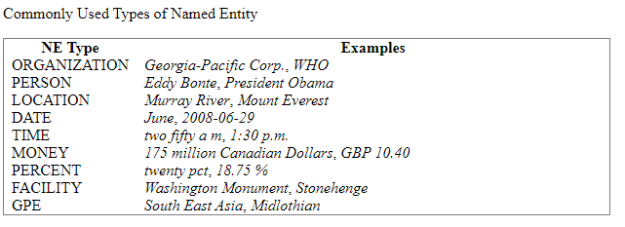

Slide 65
Which companies were mentioned in the news article?
Were specified products mentioned in complaints or reviews?
Does the tweet contain the name of a person? Does the tweet contain this person’s location?

Slide 66
TextBlob: Simplified Text Processing

Slide 67
Features
Noun phrase extraction
Part-of-speech tagging
Sentiment analysis
Classification (Naive Bayes, Decision Tree)
Language translation and detection powered by Google Translate
Tokenization (splitting text into words and sentences)
Word and phrase frequencies
Parsing
n-grams
Word inflection (pluralization and singularization) and lemmatization
Spelling correction
Add new models or languages through extensions
WordNet integration

Slide 68
Installation
Installing/Uploading from the PyPi
pip install textblob
python -m textblob.download_corpora

Slide 69
Text blob is build over NLTK library

Slide 70
A big advantage of this is, it is easy to learn and offers a lot of features like sentiment analysis, pos-tagging, noun phrase extraction, etc.

Slide 71
A good thing about TextBlob is that they are just like python strings. So, you can transform and play with it same like we did in python.

Slide 72
Pros
Since, it is built on the shoulders of NLTK and Pattern, therefore making it simple for beginners by providing an intuitive interface to NLTK.
It provides language translation and detection which is powered by Google Translate ( not provided with Spacy).

Slide 73
Cons
It is little slower in the comparison to spacy but faster than NLTK. (Spacy > TextBlob > NLTK)
It does not provide features like dependency parsing, word vectors etc. which is provided by spacy.

Slide 74
Bag of Words

Slide 75
Step1 - Collecting Data
It was the best of times,
it was the worst of times,
it was the age of wisdom,
it was the age of foolishness,
For this small example, let’s treat each line as a separate “document” and the 4 lines as our entire corpus of documents.

Slide 76
Step2 – Cleaning Data
best times
Worst times,
age wisdom,
age foolishness
remove stop words , punctuation etc to get the clean data

Slide 77
Lets count the word frequency(Histogram)
Words Frequency
best 1
times 2
age 2
widsom 1
foolishness 1

Slide 78
Convert to vectors

